Slide 1
AMIGO HIJAB
http://amigohijabs.weebly.com

Slide 2
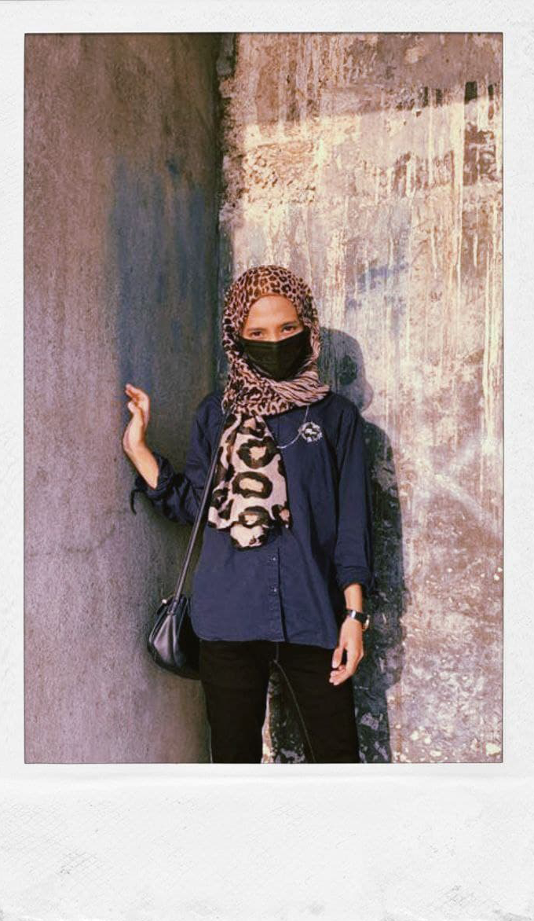
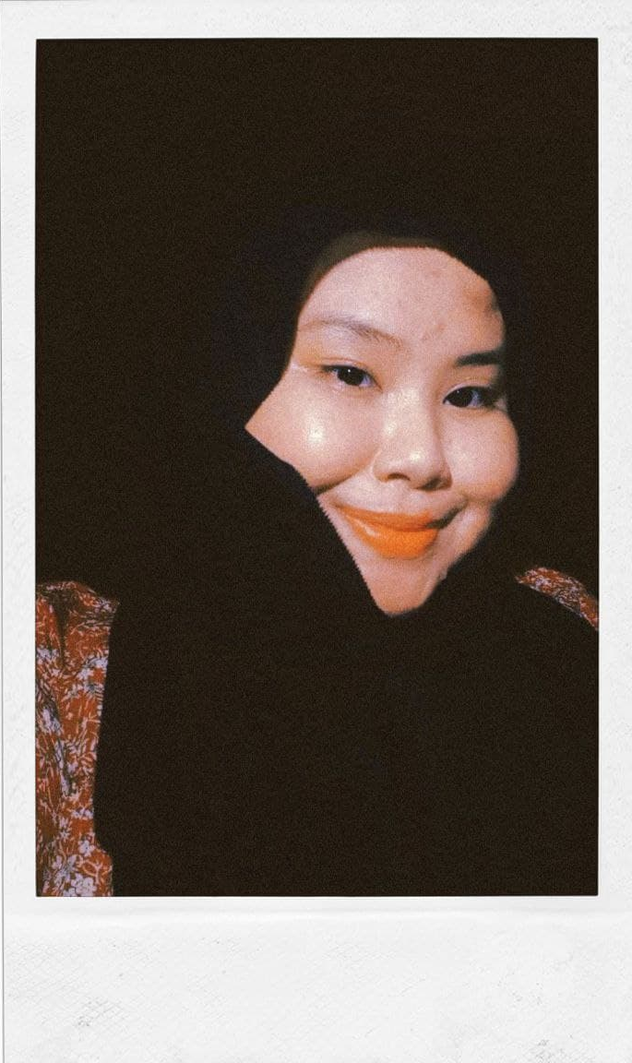
GROUP MEMBER
NUR AMIRAH SYAZWAN BINTI ABDUL AZIZ
( IPJ 200310366 )
NUR AYUNI FADYA BINTI MOHD FOAT
( IPJ 200301326 )

Slide 3
PURPOSE STATEMENT
G o a l
PRIMARY
• To show different types of hijab fashions
SECONDARY
• Share how to wear hijab fashion with toturials
OBJECTIVES
• include information and images
• include videos toturial
• giving tips on how to care and wear hijab

Slide 4
TARGET AUDIENCE
PSYCOGRAPHIC
DEMOGRAPHIC
FEMALE
AGE 10-65 YEARS OLD
Love about hijab fashions
Love to diversify the fashion of the hijab

Slide 5
PROJECT PROFILE
we have discussed to choose fashions for the title of our websites and the fashions we want to show are hijab fashions.
We divide the tasks for our group members as follows, the task for Nur Amirah Syazwan Binti Abdul Aziz is to be thorough, find resources (pictures, information), (hijab care) Website (Contact Page) Documentation (Mind map, main navigation, Storyboard) . For the job of Nur Ayuni Fadya Binti Mohd Foat is Website (Main Page, Gallery Page), (hijab tutorial) Documentation (Mind map, Introduction, Information, conclusion), Presentation slides

Slide 6
NAVIGATION STRUCTURE

Slide 7
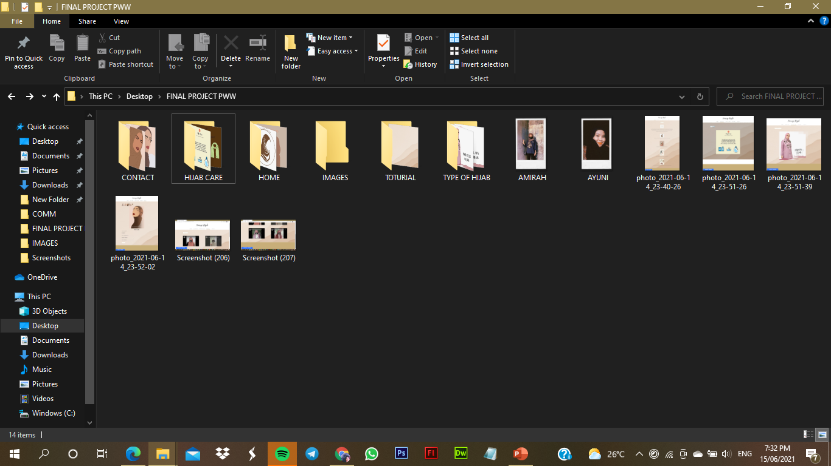
FILE ORGANISATION

Slide 8
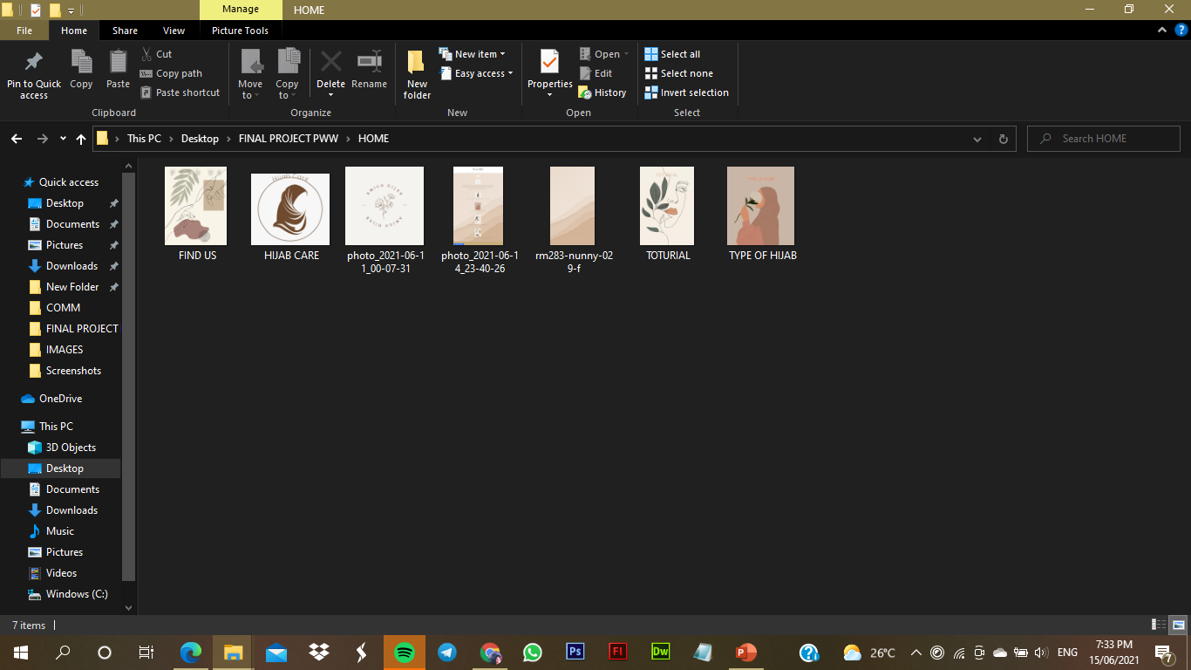
FILE IMAGES ( HOME )

Slide 9
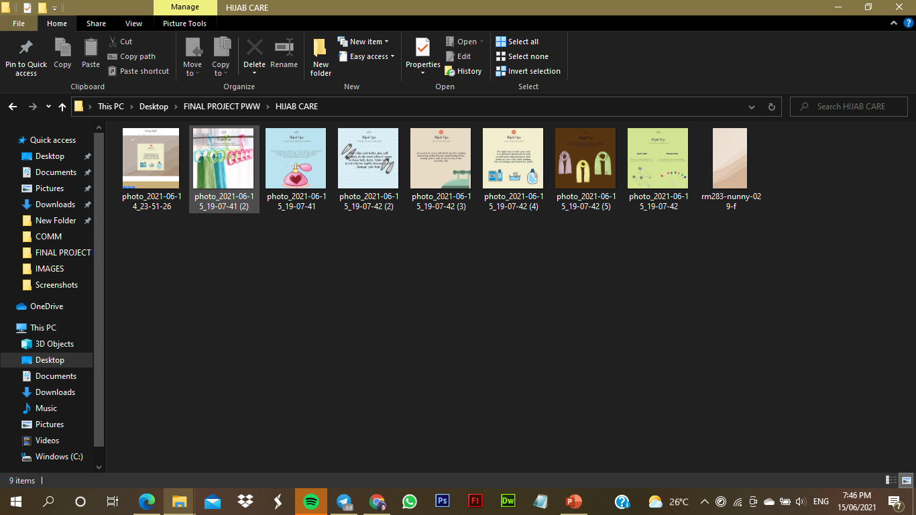
FILE IMAGES ( HIJAB CARE )

Slide 10
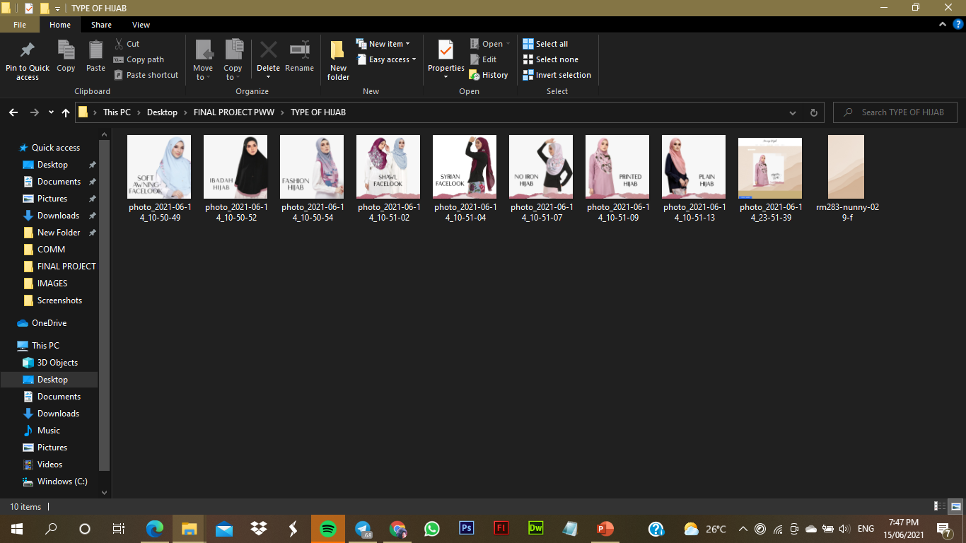
FILE IMAGES ( TYPE OF HIJAB )

Slide 11
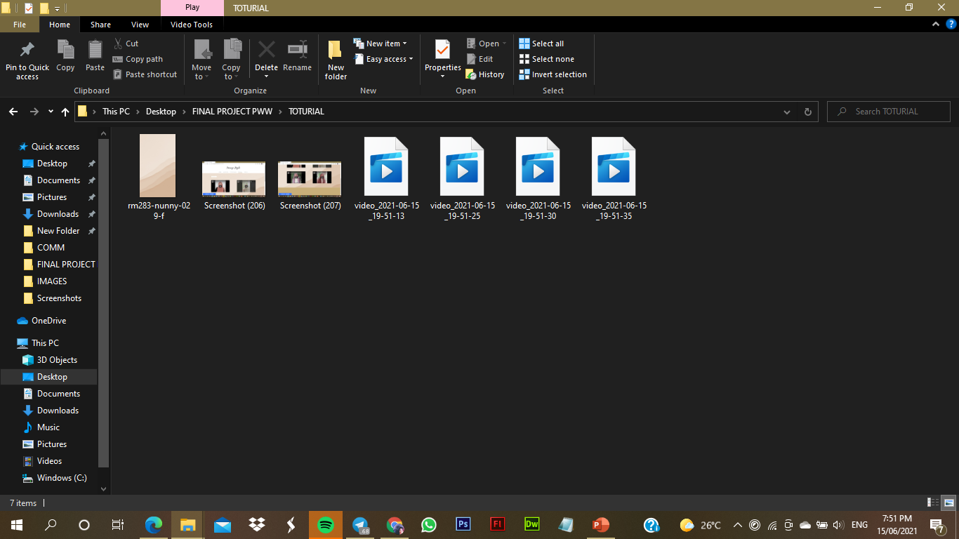
FILE / IMAGES VIDEO (TOTURIAL )

Slide 12
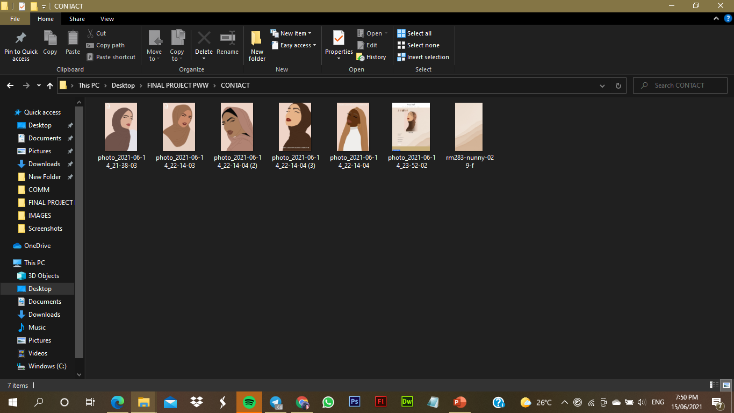
FILE IMAGES (CONTACT )

Slide 13
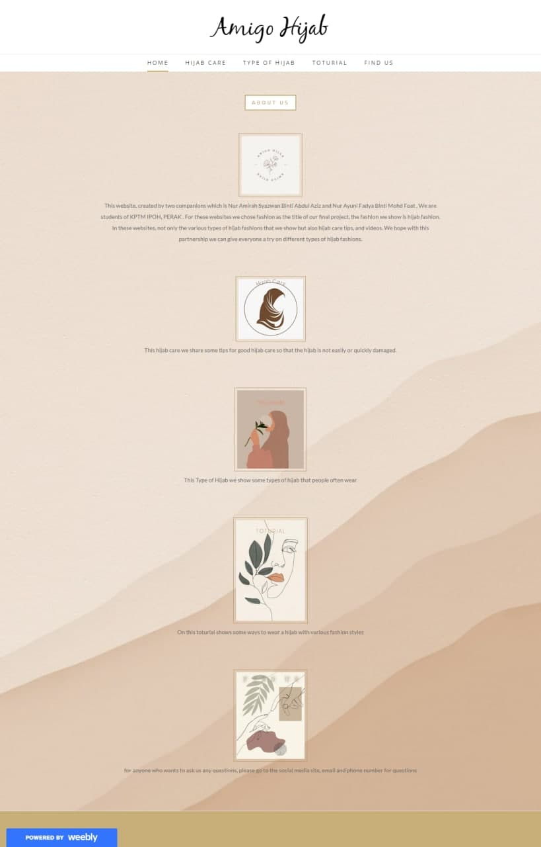
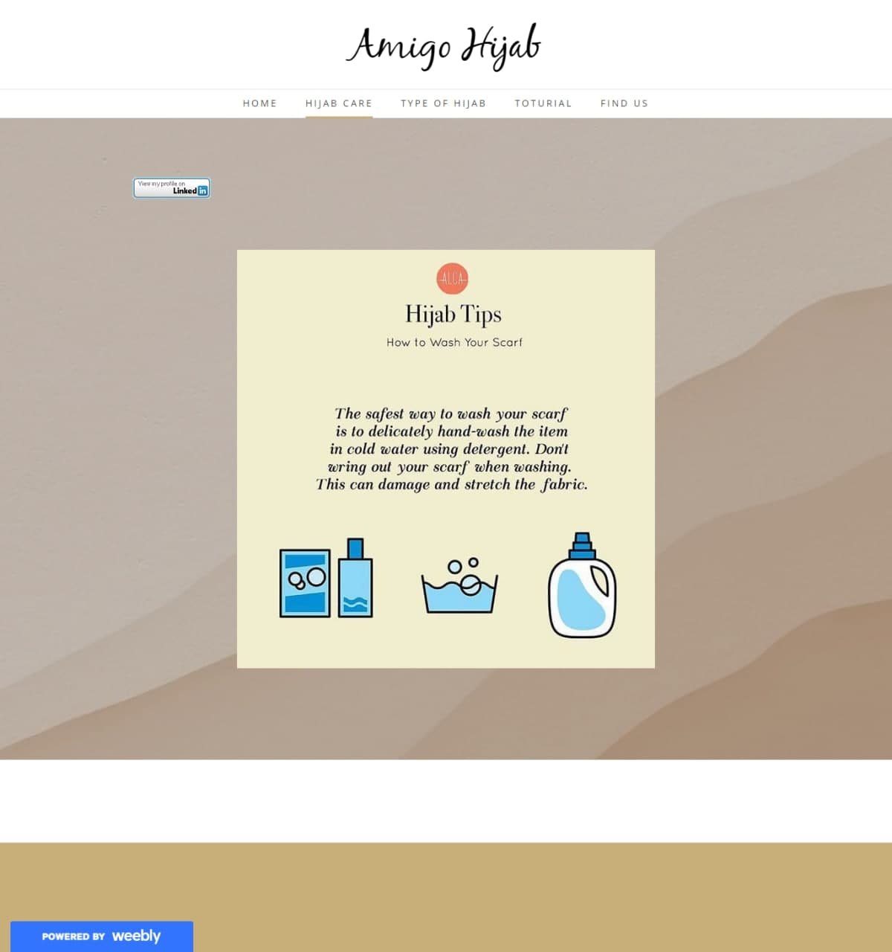
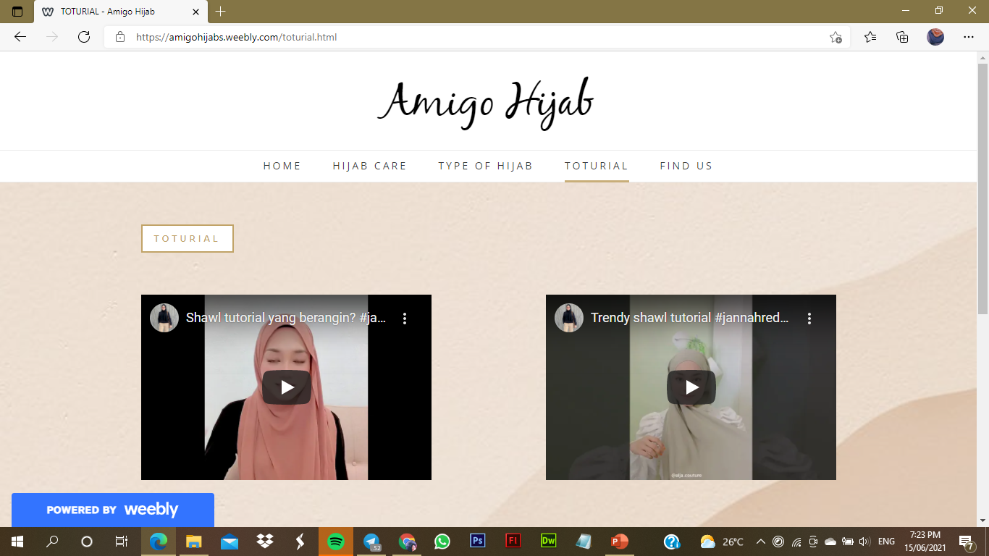
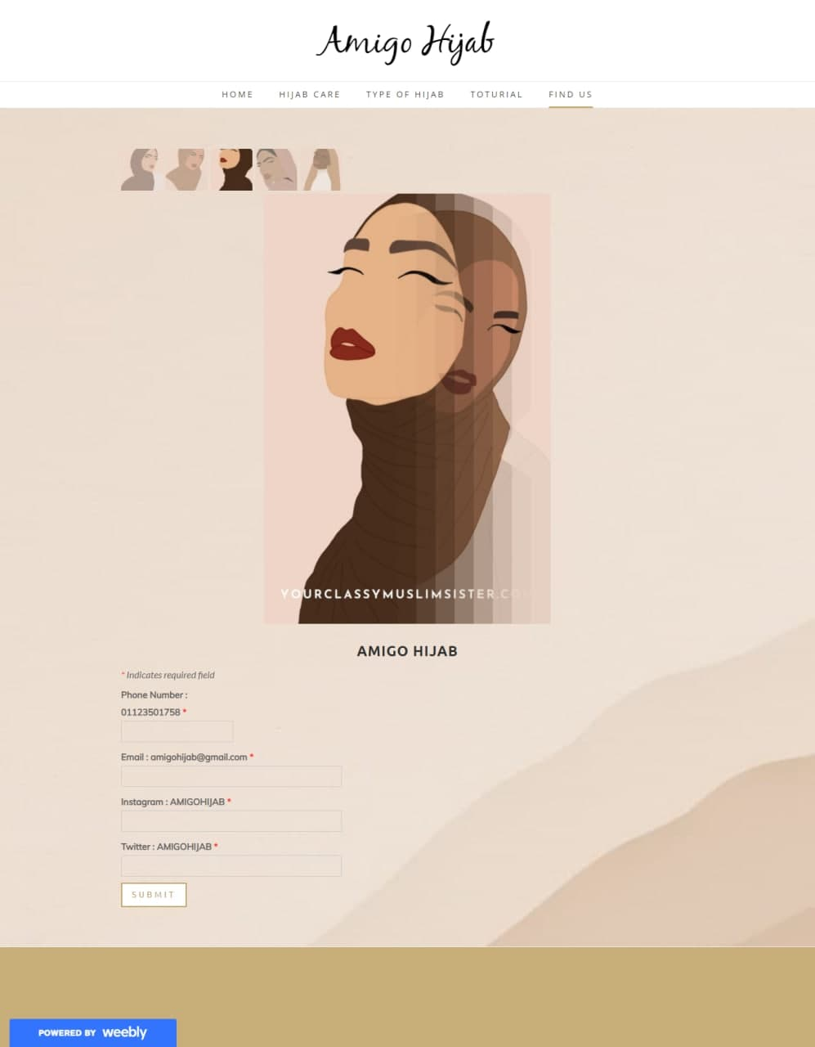
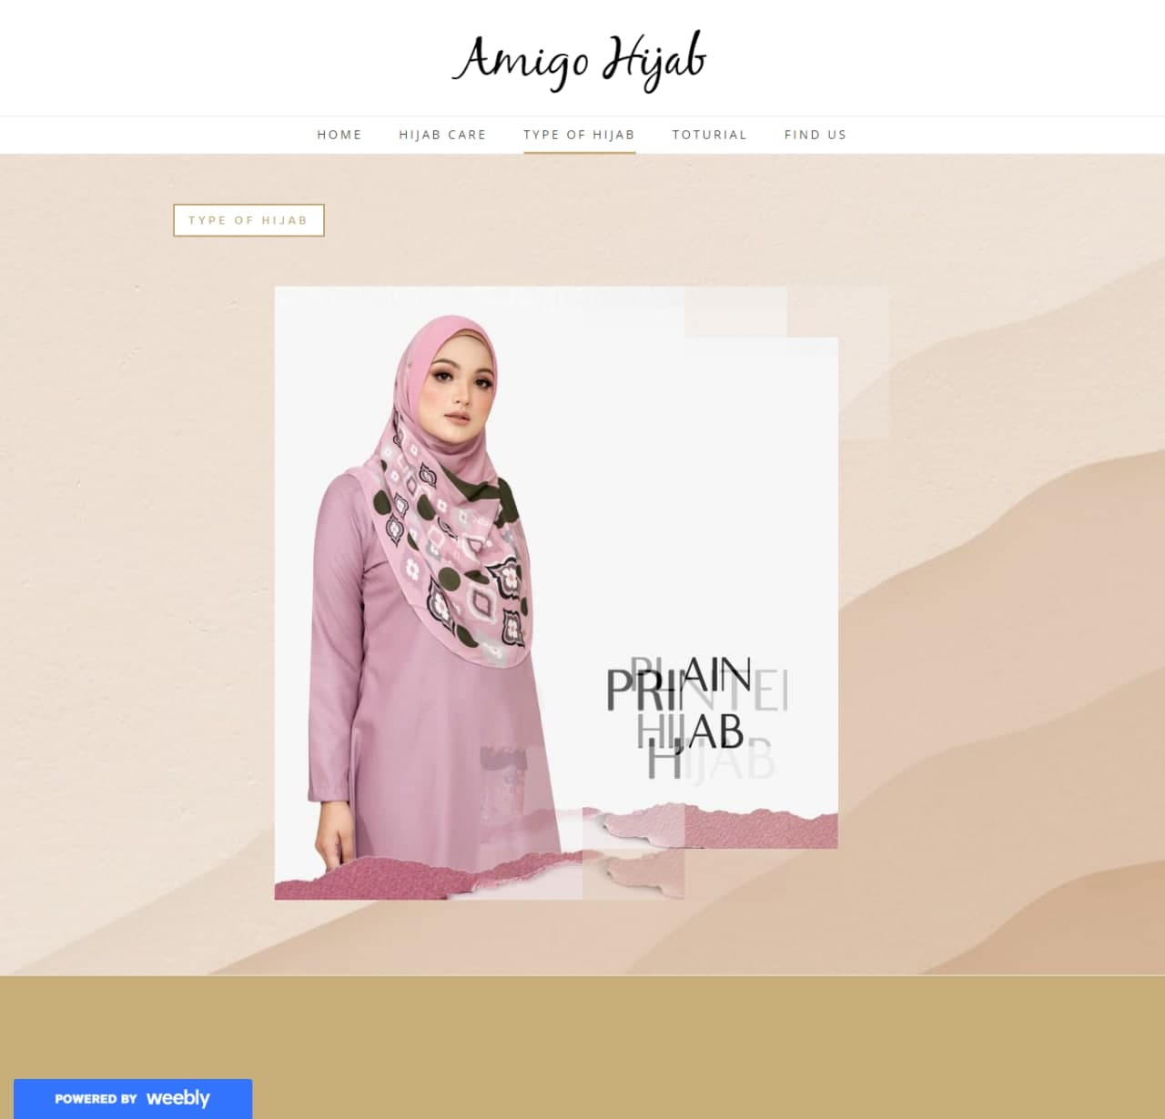
OUR WEBSITES

Slide 14
THANKYOU!! ☺

